Slide 1
Learning Objectives
7.1 Constructors
7.1.1 Definitions
7.1.2 Calling
7.2 More Tools
7.2.1 const parameter modifier
7.2.2 Inline functions
7.2.3 Static member data
7.3 Vectors
7.3.1 Introduction to vector class
Notes:
Headings should be set in title case and blue colour. (Title case means capitalizing the first letter of each words that are not articles or prepositions, e.g. Road Map to Success. It does not mean all caps.)

Slide 2
Constructors
Initialization of objects
Initialize some or all member variables
Other actions possible as well
A special kind of member function
Automatically called when object declared
Very useful tool
Key principle of OOP

Slide 3
Constructor Definitions
Constructors defined like any member function
Except:
Must have same name as class
Cannot return a value; not even void!

Slide 4
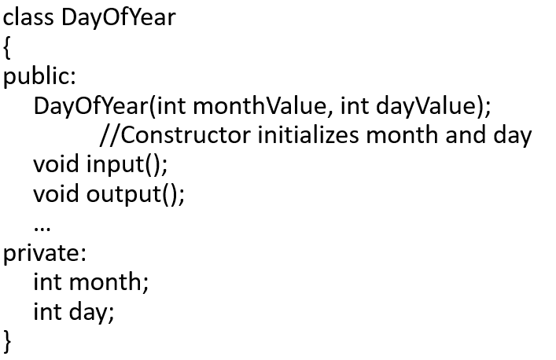
Constructor Definition Example
Class definition with constructor:

Slide 5
Constructor Notes
Notice name of constructor: DayOfYear
Same name as class itself!
Constructor declaration has no return-type
Not even void!
Constructor in public section
It’s called when objects are declared
If private, could never declare objects!

Slide 6
Calling Constructors
Declare objects: DayOfYear date1(7, 4), date2(5, 5);
Objects are created here
Constructor is called
Values in parens passed as arguments to constructor
Member variables month, day initialized: date1.month→7 date2.month →5 date1.dat → 4 date2.day → 5

Slide 7
Constructor Equivalency
Consider:
DayOfYear date1, date2 date1.DayOfYear(7, 4); // ILLEGAL! date2.DayOfYear(5, 5); // ILLEGAL!
Seemingly OK…
CANNOT call constructors like other member functions!

Slide 8
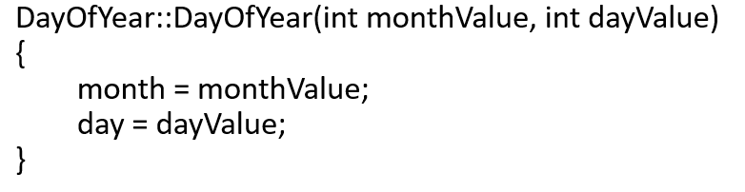
Constructor Code
Constructor definition is like all other member functions:
Note same name around ::
Clearly identifies a constructor
Note no return type
Just as in class definition

Slide 9
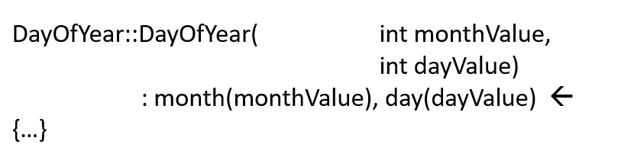
Alternative Definition
Previous definition equivalent to:
Third line called “Initialization Section”
Body left empty
Preferable definition version

Slide 10
Constructor Additional Purpose
Not just initialize data
Body doesn’t have to be empty
In initializer version
Validate the data!
Ensure only appropriate data is assigned to class private member variables
Powerful O O P principle

Slide 11
Overloaded Constructors
Can overload constructors just like other functions
Recall: a signature consists of:
Name of function
Parameter list
Provide constructors for all possible argument-lists
Particularly “how many”

Slide 12
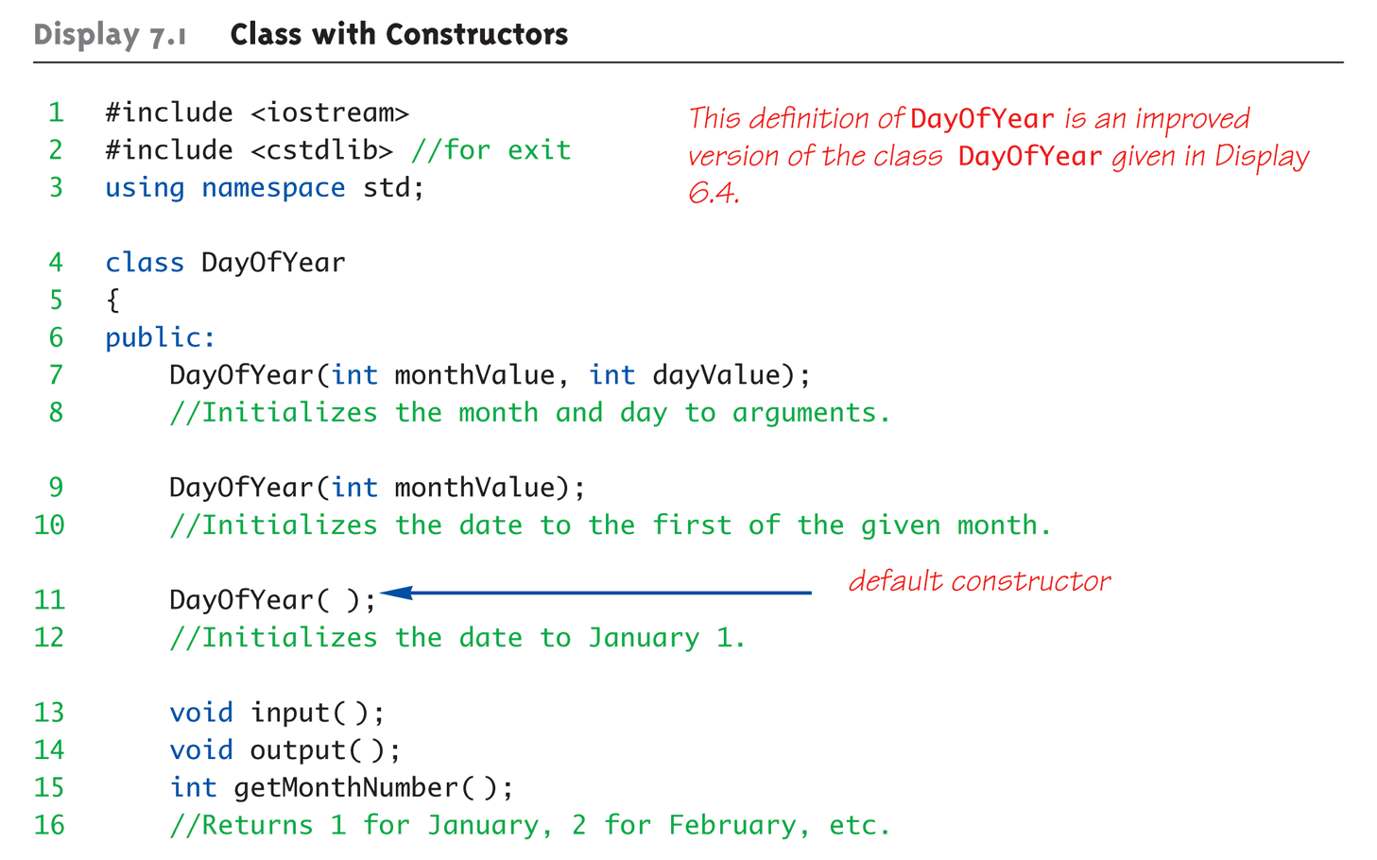
Class with Constructors Example: Display 7.1 Class with Constructors (1 of 3)

Slide 13
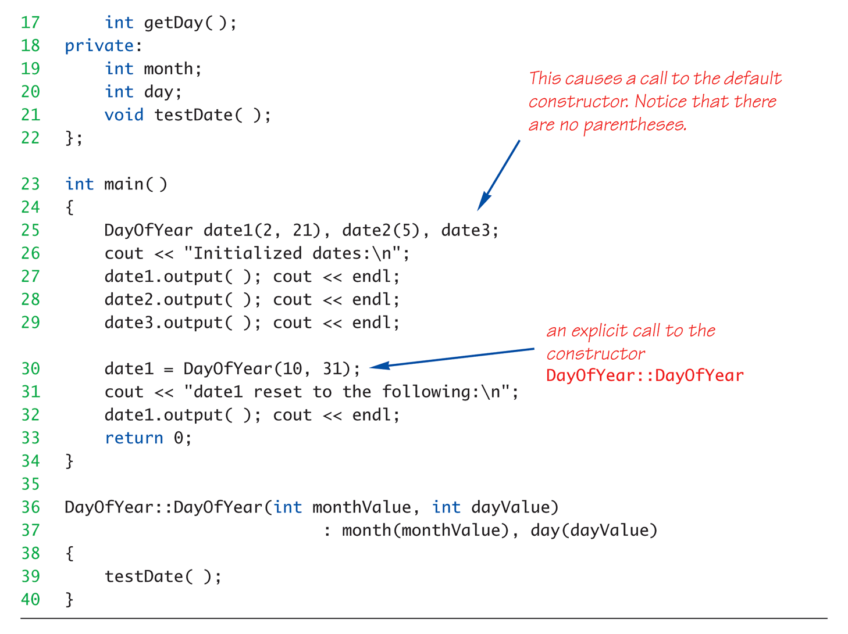
Class with Constructors Example: Display 7.1 Class with Constructors (2 of 3)

Slide 14
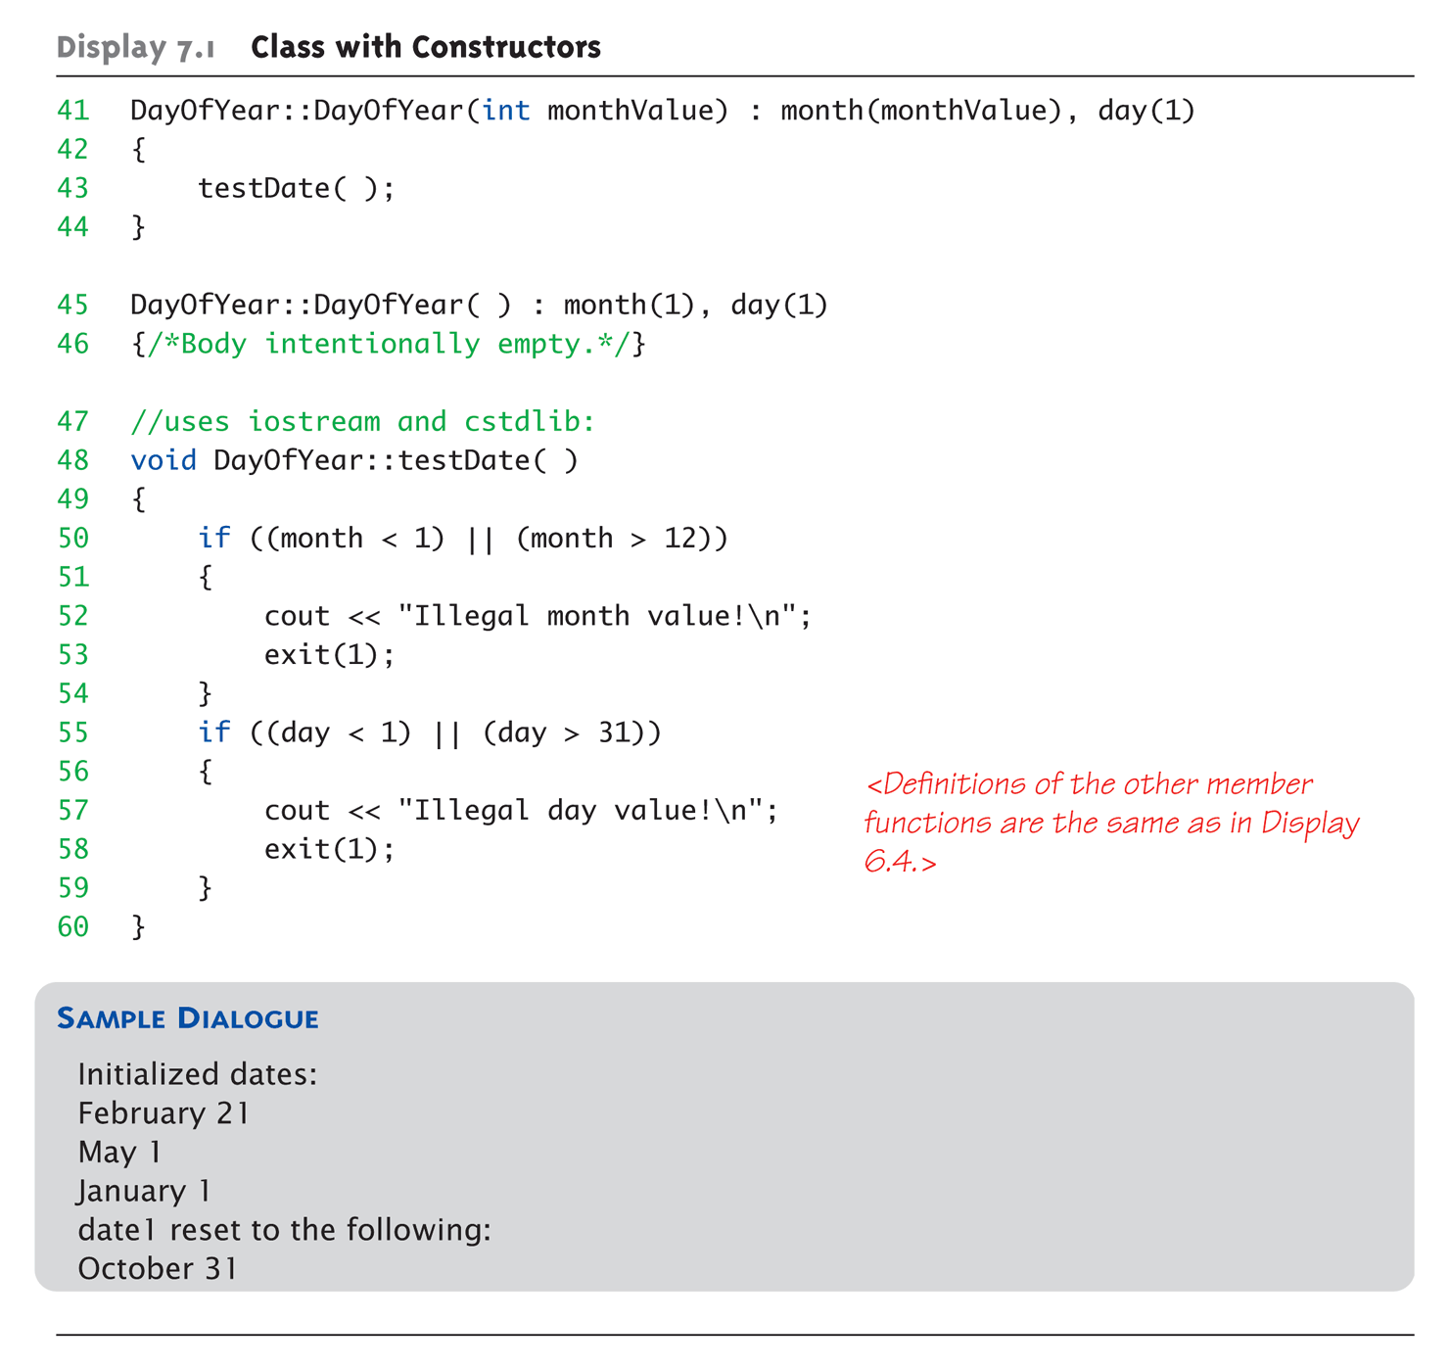
Class with Constructors Example: Display 7.1 Class with Constructors (3 of 3)

Slide 15
Constructor with No Arguments
Can be confusing
Standard functions with no arguments:
Called with syntax: callMyFunction();
Including empty parentheses
Object declarations with no “initializers”:
DayOfYear date1; // This way!
DayOfYear date(); // NO!
What is this really?
Compiler sees a function declaration/prototype!
Yes! Look closely!

Slide 16
Explicit Constructor Calls
Can also call constructor AGAIN
After object declared
Recall: constructor was automatically called then
Can call via object’s name; standard member function call
Convenient method of setting member variables
Method quite different from standard member function call

Slide 17
Explicit Constructor Call Example
Such a call returns “anonymous object”
Which can then be assigned
In Action: DayOfYear holiday(7, 4);
Constructor called at object’s declaration
Now to “re-initialize”: holiday = DayOfYear(5, 5);
Explicit constructor call
Returns new “anonymous object”
Assigned back to current object

Slide 18
Default Constructor
Defined as: constructor w/ no arguments
One should always be defined
Auto-Generated?
Yes & No
If no constructors AT ALL are defined→ Yes
If any constructors are defined→ No
If no default constructor:
Cannot declare: MyClass myObject;
With no initializers

Slide 19
Class Type Member Variables
Class member variables can be any type
Including objects of other classes!
Type of class relationship
Powerful O O P principle
Need special notation for constructors
So they can call “back” to member object’s constructor

Slide 20
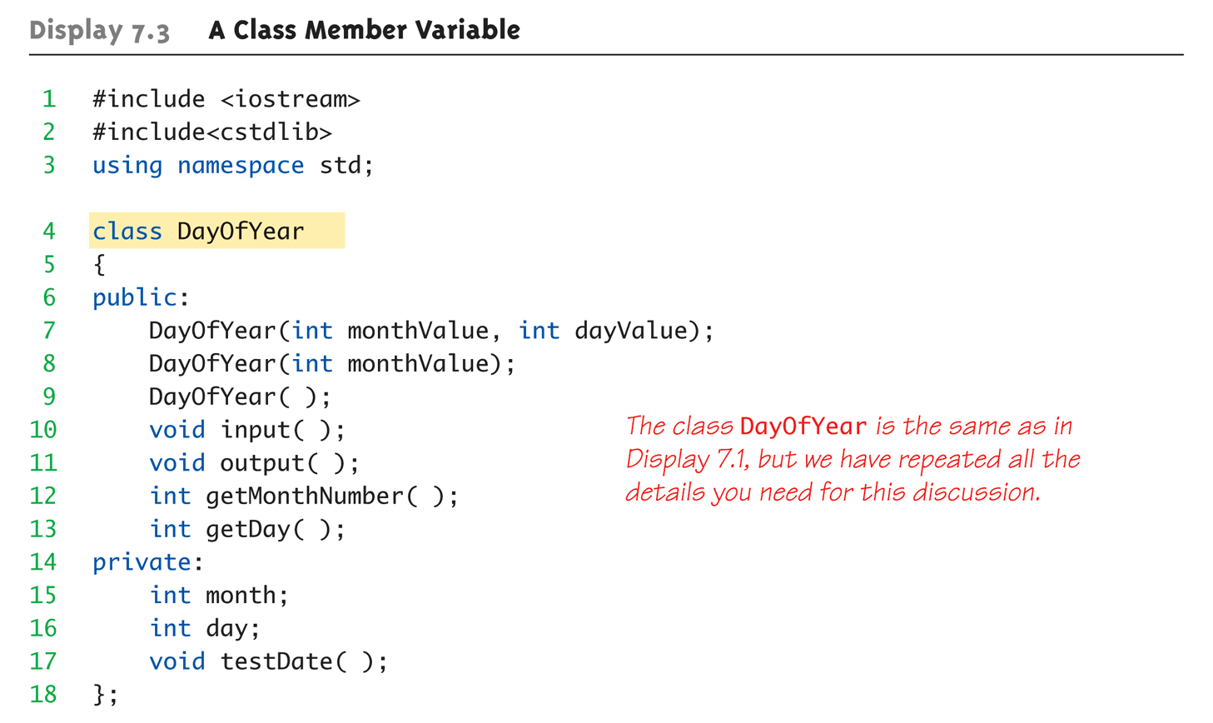
Class Member Variable Example: Display 7.3 A Class Member Variable (1 of 5)

Slide 21
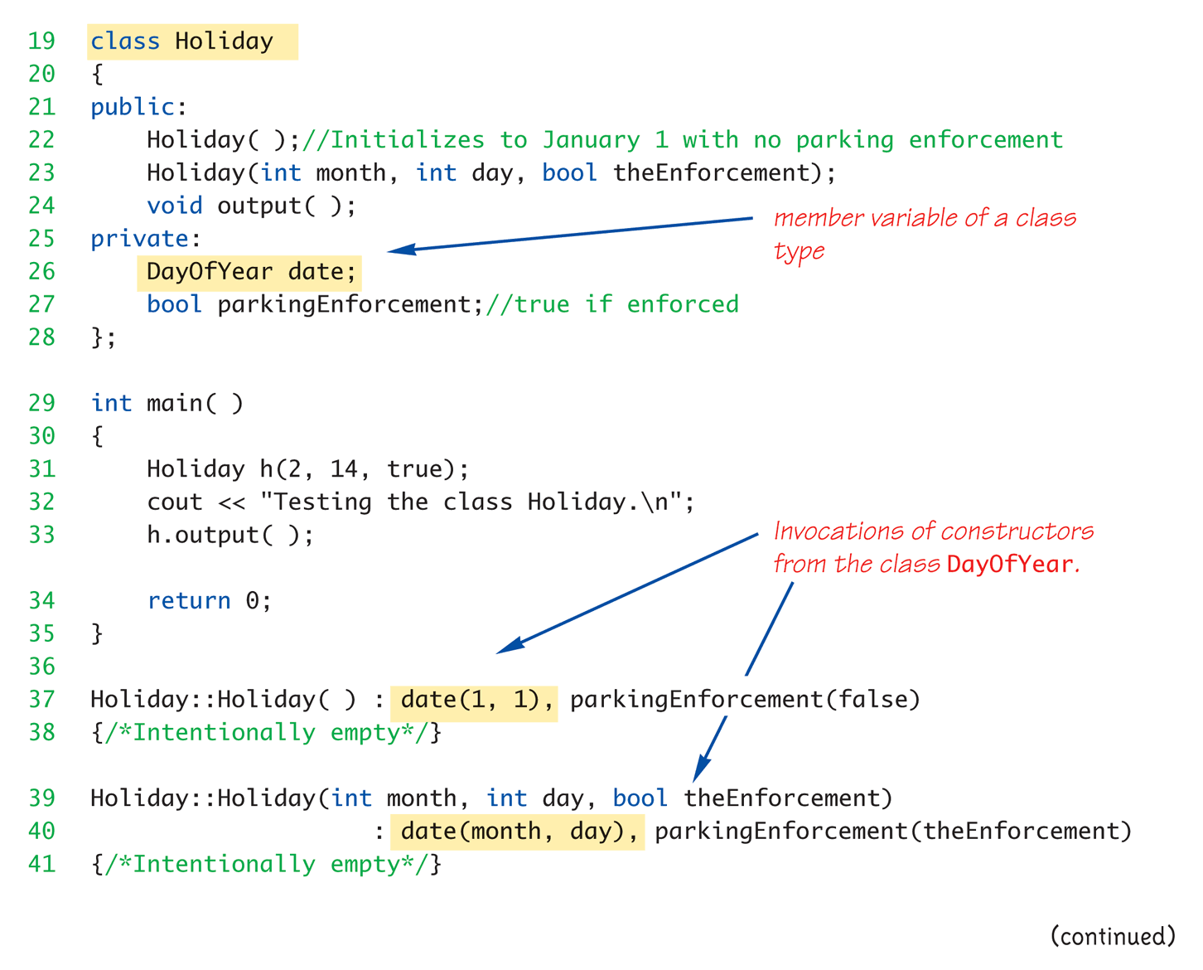
Class Member Variable Example: Display 7.3 A Class Member Variable (2 of 5)

Slide 22
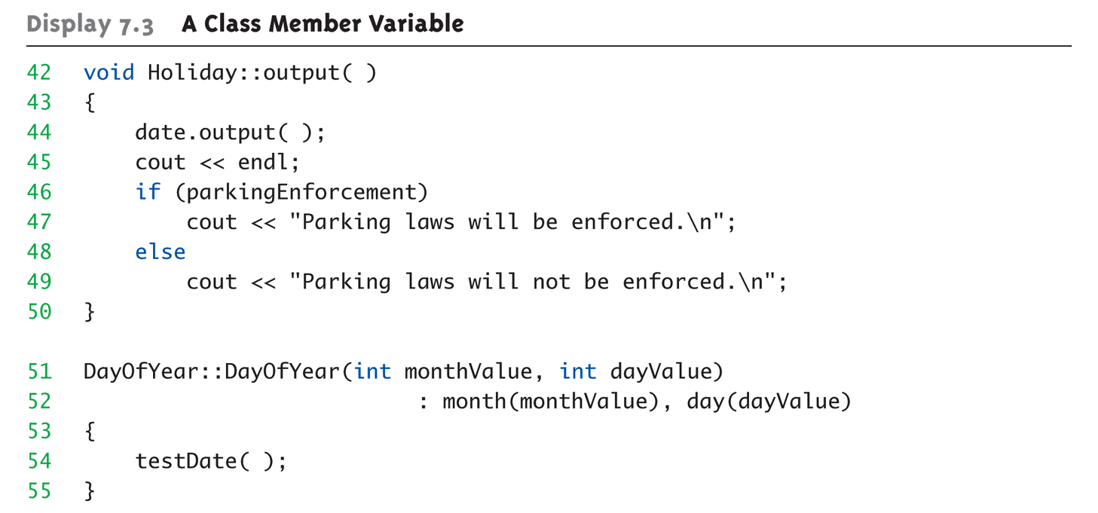
Class Member Variable Example: Display 7.3 A Class Member Variable (3 of 5)

Slide 23
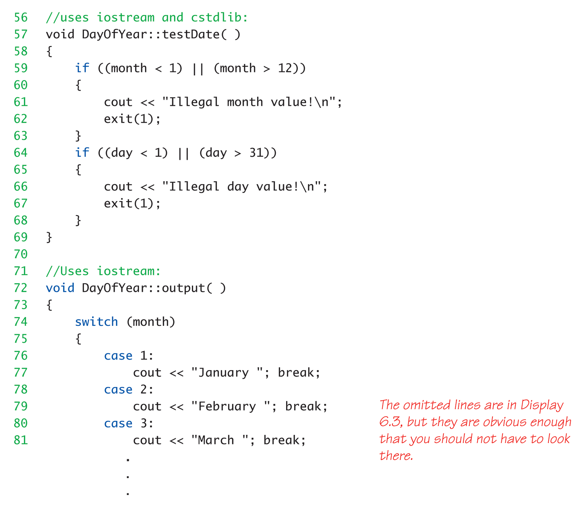
Class Member Variable Example: Display 7.3 A Class Member Variable (4 of 5)

Slide 24
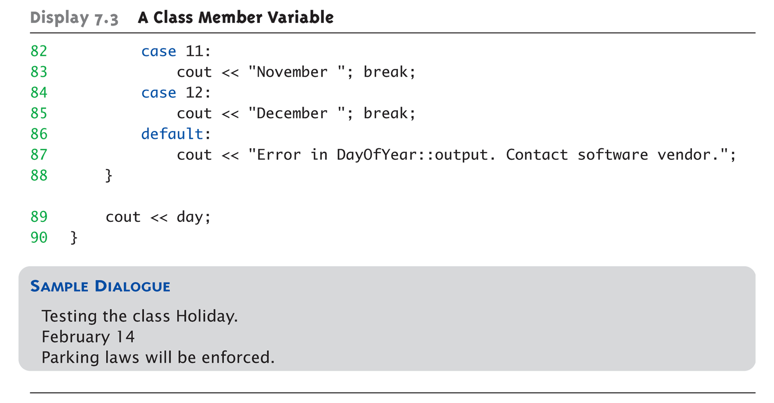
Class Member Variable Example: Display 7.3 A Class Member Variable (5 of 5)

Slide 25
Parameter Passing Methods
Efficiency of parameter passing
Call-by-value
Requires copy be made→Overhead
Call-by-reference
Placeholder for actual argument
Most efficient method
Negligible difference for simple types
For class types→clear advantage
Call-by-reference desirable
Especially for “large” data, like class types

Slide 26
The const Parameter Modifier
Large data types (typically classes)
Desirable to use pass-by-reference
Even if function will not make modifications
Protect argument
Use constant parameter
Also called constant call-by-reference parameter
Place keyword const before type
Makes parameter “read-only”
Attempt to modify parameter results in compiler error

Slide 27
Use of const
All-or-nothing
If no need for function modifications
Protect parameter with const
Protect ALL such parameters
This includes class member function parameters

Slide 28
Inline Functions
For non-member functions:
Use keyword inline in function declaration and function heading
For class member functions:
Place implementation (code) for function IN class definition → automatically inline
Use for very short functions only
Code actually inserted in place of call
Eliminates overhead
More efficient, but only when short!

Slide 29
Inline Member Functions
Member function definitions
Typically defined separately, in different file
Can be defined IN class definition
Makes function “in-line”
Again: use for very short functions only
More efficient
If too long → actually less efficient!

Slide 30
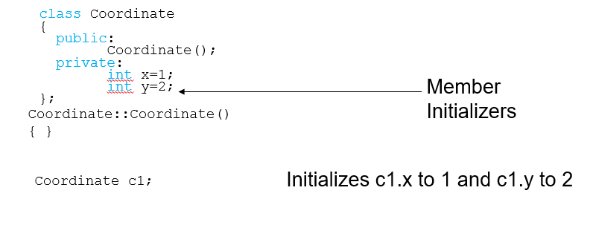
Member Initializers
C++11 supports a feature called member initialization
This feature allows you to set default values for member variables

Slide 31
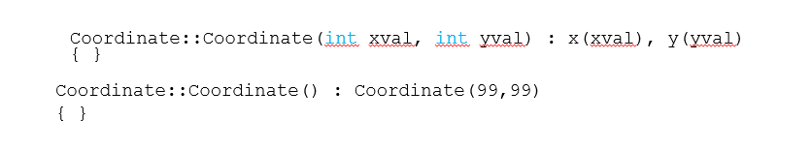
Constructor Delegation
C++11 allows one constructor to invoke another
The default constructor invokes the constructor to initialize x and y to 99,99

Slide 32
Static Members
Static member variables
All objects of class “share” one copy
One object changes it →all see change
Useful for “tracking”
How often a member function is called
How many objects exist at given time
Place keyword static before type

Slide 33
Static Functions
Member functions can be static
If no access to object data needed
And still “must” be member of the class
Make it a static function
Can then be called outside class
From non-class objects:
E.g., Server::getTurn();
As well as via class objects
Standard method: myObject.getTurn();
Can only use static data, functions!

Slide 34
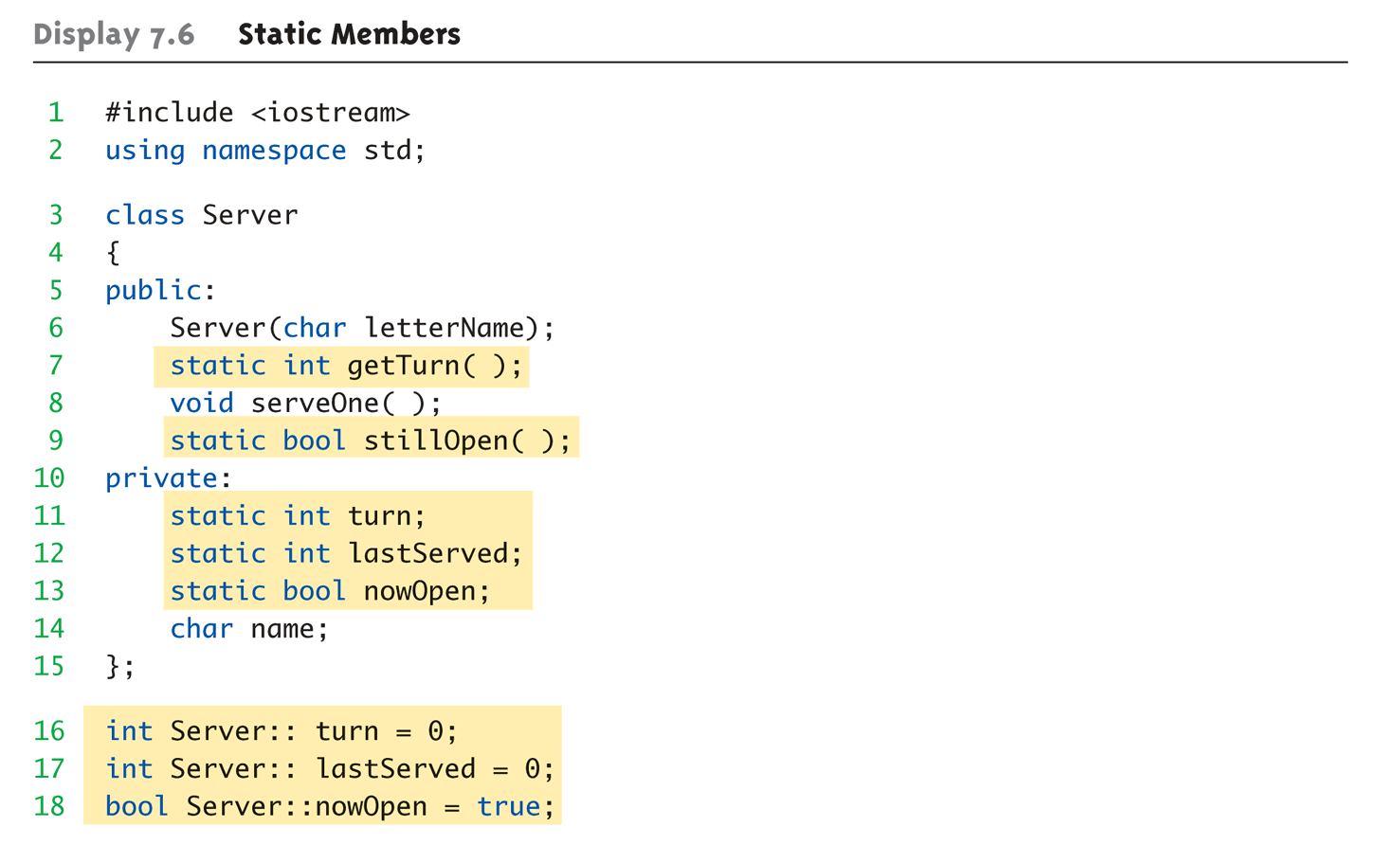
Static Members Example: Display 7.6 Static Members (1 of 4)

Slide 35
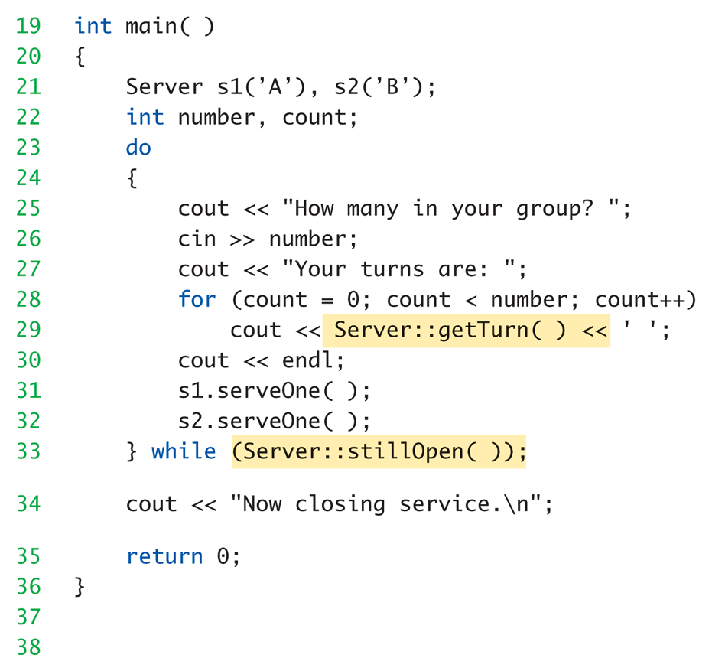
Static Members Example: Display 7.6 Static Members (2 of 4)

Slide 36
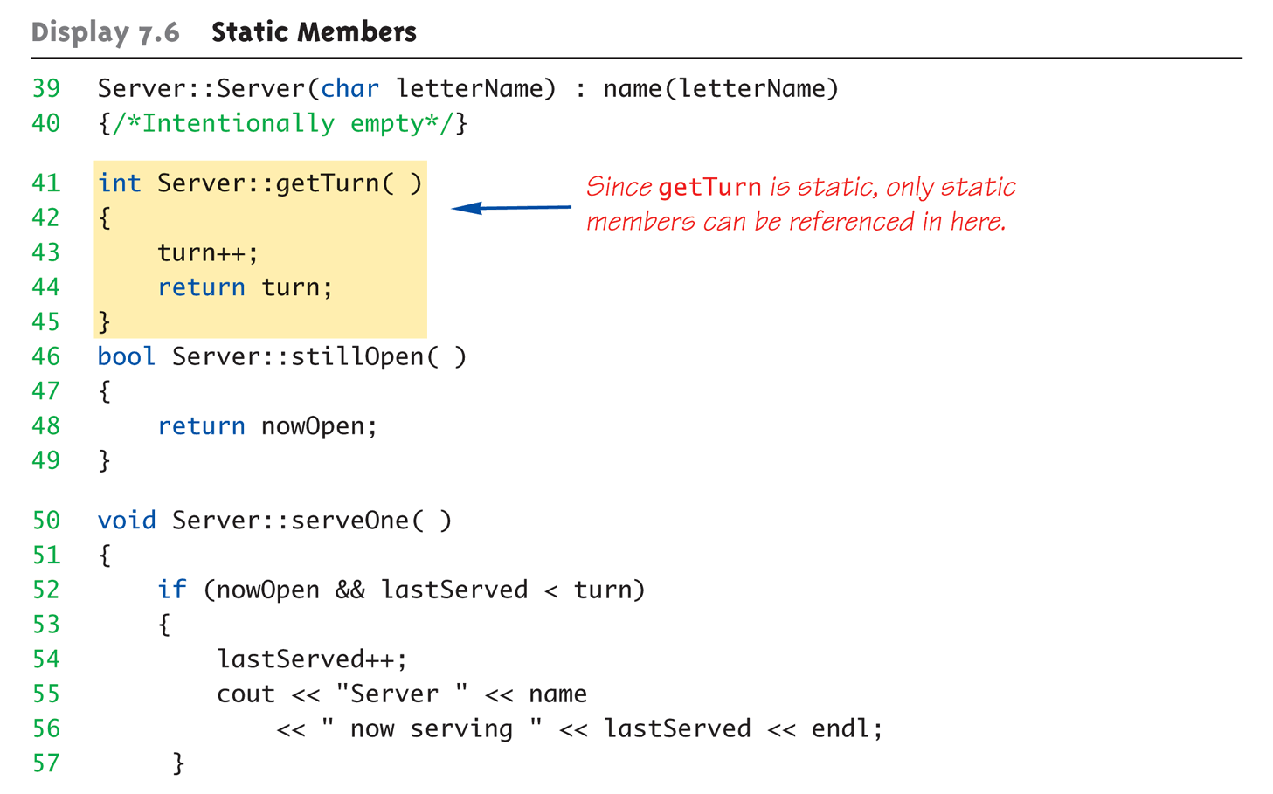
Static Members Example: Display 7.6 Static Members (3 of 4)

Slide 37
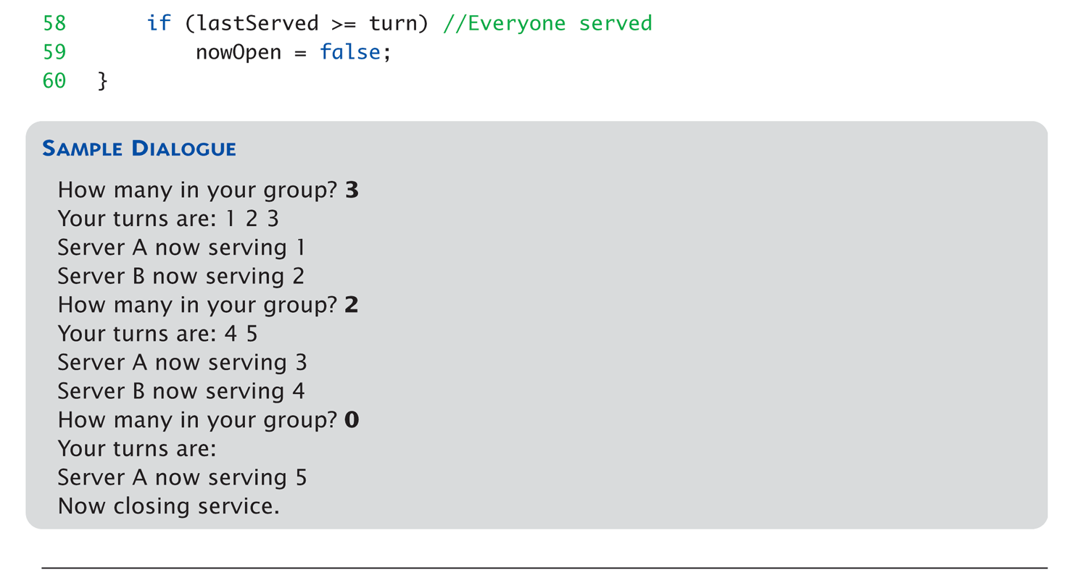
Static Members Example: Display 7.6 Static Members (4 of 4)

Slide 38
Vectors
Vector Introduction
Recall: arrays are fixed size
Vectors: “arrays that grow and shrink”
During program execution
Formed from Standard Template Library (STL)
Using template class

Slide 39
Vector Basics
Similar to array:
Has base type
Stores collection of base type values
Declared differently:
Syntax: vector<Base_Type>
Indicates template class
Any type can be “plugged in” to Base_Type
Produces “new” class for vectors with that type
Example declaration: vector<int> v;

Slide 40
Vector Use
vector<int> v;
“v is vector of type int”
Calls class default constructor
Empty vector object created
Indexed like arrays for access
But to add elements:
Must call member function push_back
Member function size()
Returns current number of elements

Slide 41
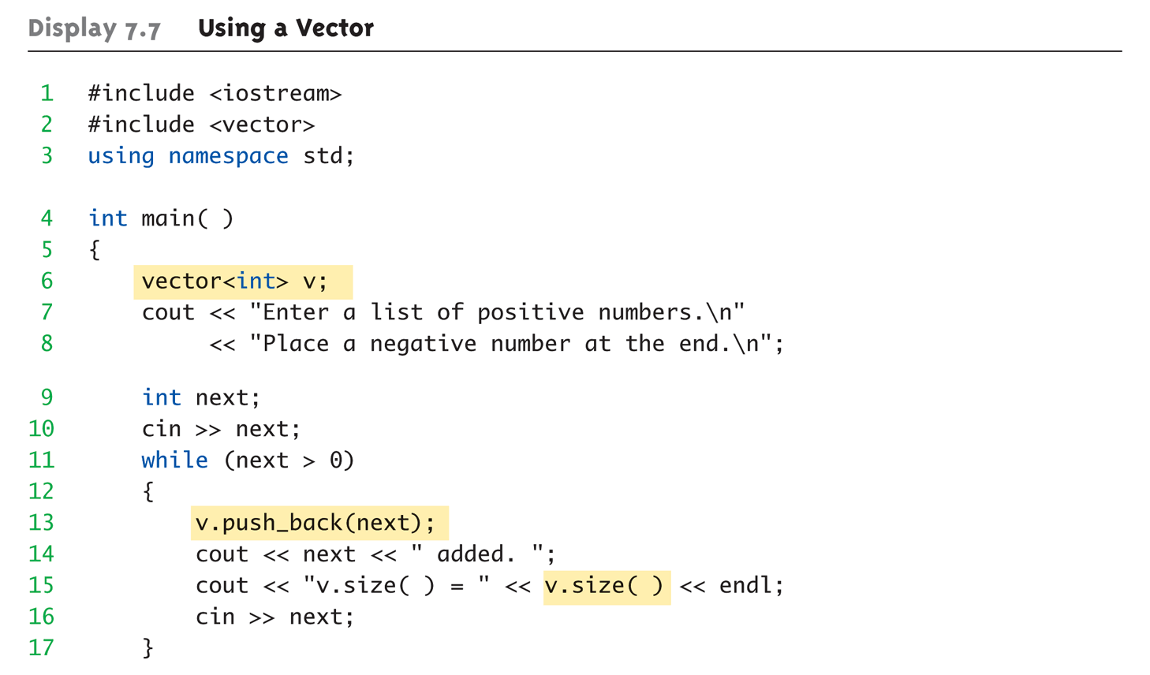
Vector Example: Display 7.7 Using a Vector (1 of 2)

Slide 42
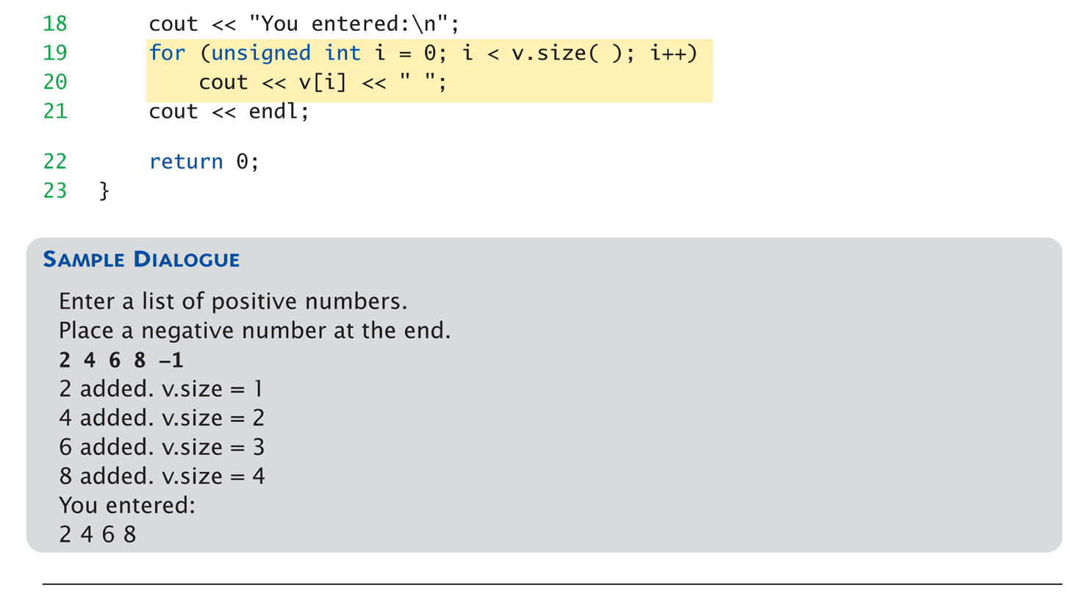
Vector Example: Display 7.7 Using a Vector (2 of 2)

Slide 43
Vector Efficiency
Member function capacity()
Returns memory currently allocated
Not same as size()
Capacity typically > size
Automatically increased as needed
If efficiency critical:
Can set behaviors manually
v.reserve(32); //sets capacity to 32
v.reserve(v.size()+10); //sets capacity to 10 more than size

Slide 44
Summary 1
Constructors: automatic initialization of class data
Called when objects are declared
Constructor has same name as class
Default constructor has no parameters
Should always be defined
Class member variables
Can be objects of other classes
Require initialization-section

Slide 45
Summary 2
Constant call-by-reference parameters
More efficient than call-by-value
Can inline very short function definitions
Can improve efficiency
Static member variables
Shared by all objects of a class
Vector classes
Like: “arrays that grow and shrink”

